Slide 1
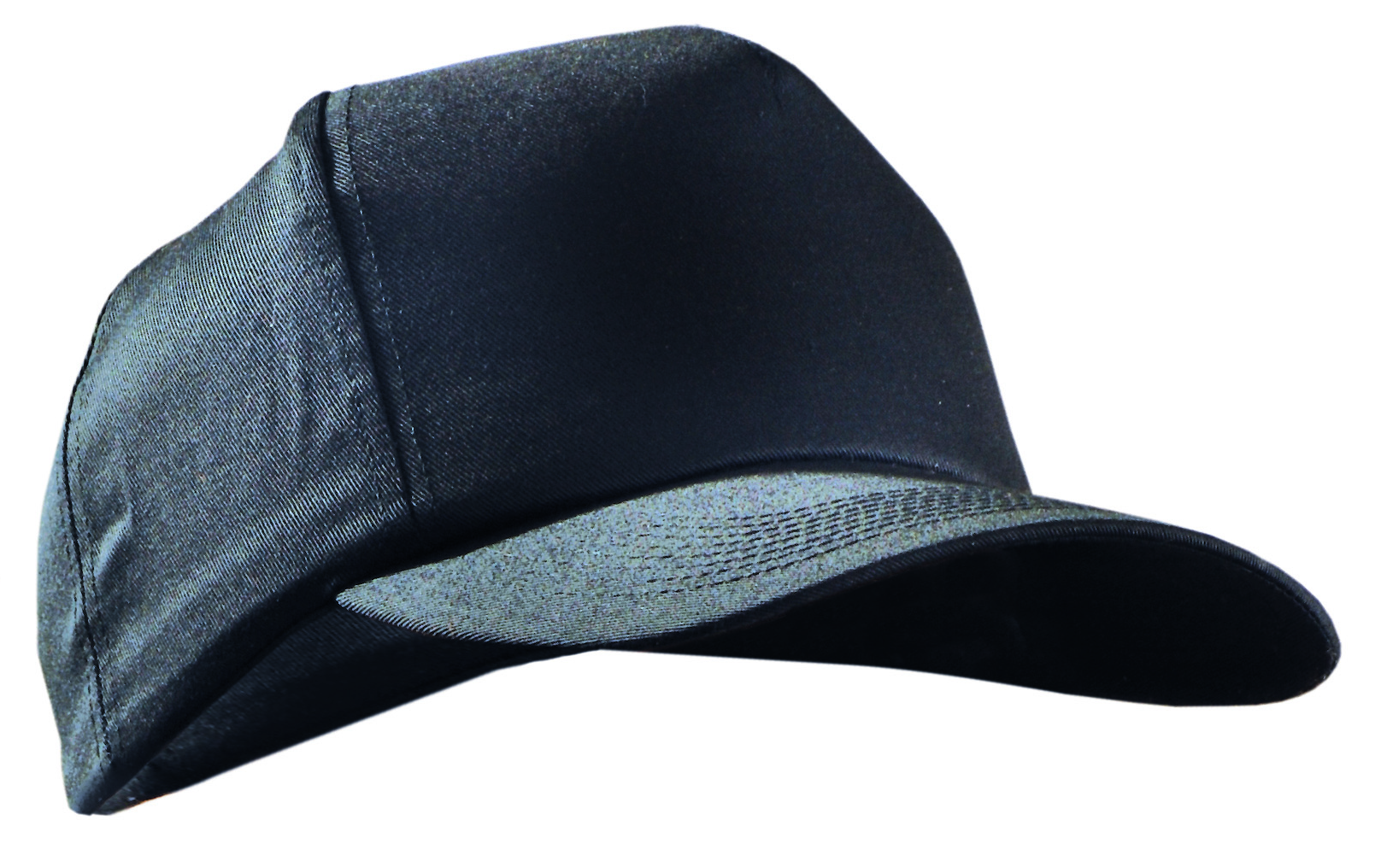
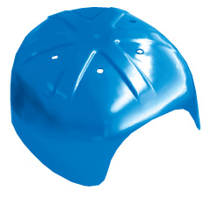
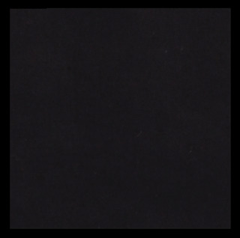
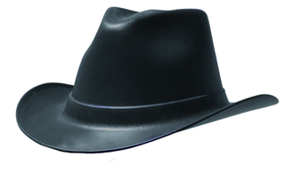

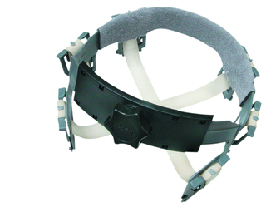

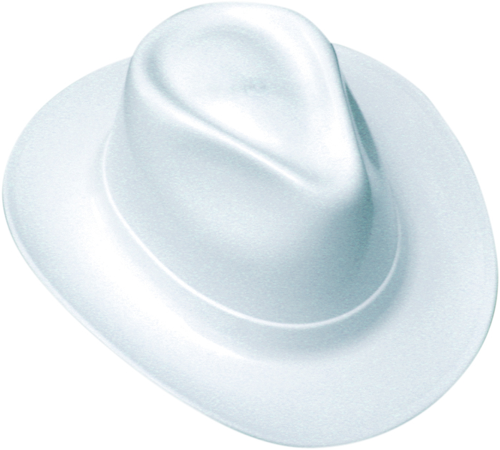
HEAD PROTECTION
PROTECT AGAINST BUMPS & SCRAPES
BASEBALL STYLE BUMP CAP
• 100% Polyester Twill
Baseball Cap
• Polyethylene Bump Cap
Insert Included
• Insert Fits Most “High
Profile” Ball Caps
• One Size
• Colors: Navy, Black
V410-03 Navy
V410-06 Black
V400 (Insert only)
COWBOY STYLE HARD HAT
• Ratchet Suspension
• 6 Pt. Deluxe Nylon, Ratchet
Suspension
• Terry Cloth Sweatband
• Extra Wide Brim for More
UV Protection
• Shell Made in USA
• Meets: Z89.1, Type 1, Class E &G
• Colors: Black, White
VCB200-06 Black
VCB200-00 White

